Slide 1
Query Optimization

Slide 2
Introduction
Query optimization
Conducted by a query optimizer in a DBMS
Goal: select best available strategy for executing query
Based on information available
Most RDBMSs use a tree as the internal representation of a query

Slide 3
19.1 Query Trees and Heuristics for Query Optimization
Step 1: scanner and parser generate initial query representation
Step 2: representation is optimized according to heuristic rules
Step 3: query execution plan is developed
Execute groups of operations based on access paths available and files involved

Slide 4
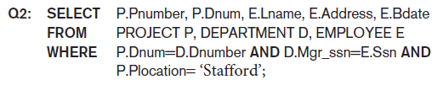
Query Trees and Heuristics for Query Optimization (cont’d.)
Example heuristic rule
Apply SELECT and PROJECT before JOIN
Reduces size of files to be joined
Query tree
Represents relational algebra expression
Query graph
Represents relational calculus expression
Example for Q2 on next slide

Slide 5
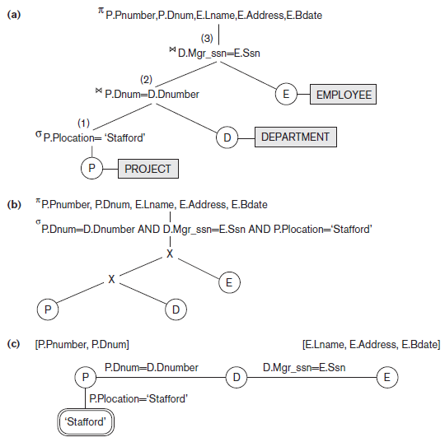
Query Trees and Query Graph Corresponding to Q2
Figure 19.1 Two query trees for the query Q2.
(a) Query tree corresponding to the relational algebra expression for Q2.
(b) Initial (canonical) query tree for SQL query Q2.
(c) Query graph for Q2.

Slide 6
Query Trees and Heuristics for Query Optimization (cont’d.)
Query tree represents a specific order of operations for executing a query
Preferred to query graph for this reason
Query graph
Relation nodes displayed as single circles
Constants represented by constant nodes
Double circles or ovals
Selection or join conditions represented as edges
Attributes to be retrieved displayed in square brackets

Slide 7
Heuristic Optimization of Query Trees
Many different query trees can be used to represent the query and get the same results
Figure 19.1b shows initial tree for Q2
Very inefficient - will never be executed
Optimizer will transform into equivalent final query tree

Slide 8
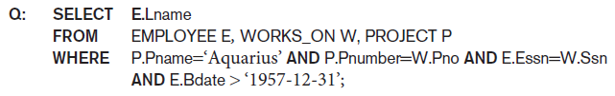
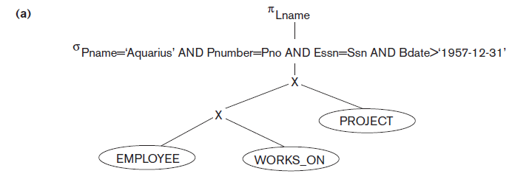
Query Transformation Example
Figure 19.2 Steps in converting a query tree during heuristic optimization. (a) Initial (canonical) query tree for SQL query Q.

Slide 9
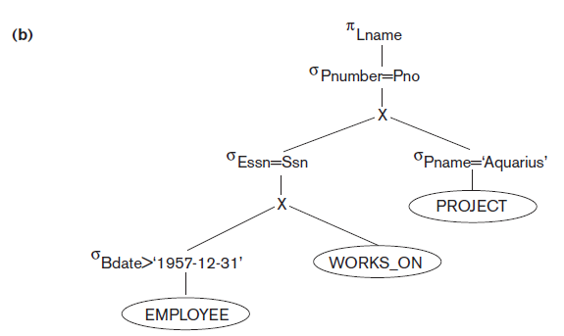
Query Transformation Example (cont’d.)
Figure 19.2 Steps in converting a query tree during heuristic optimization
(b) Moving SELECT operations down the query tree.

Slide 10
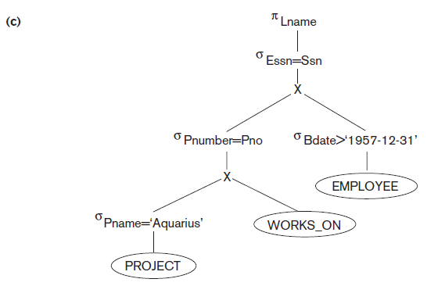
Query Transformation Example (cont’d.)
Figure 19.2 Steps in converting a query tree during heuristic optimization
(c) Applying the more restrictive SELECT operation first.

Slide 11
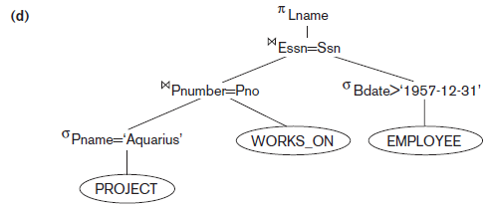
Query Transformation Example (cont’d.)
Figure 19.2 Steps in converting a query tree during heuristic optimization
(d) Replacing CARTESIAN PRODUCT and SELECT with JOIN operations.

Slide 12
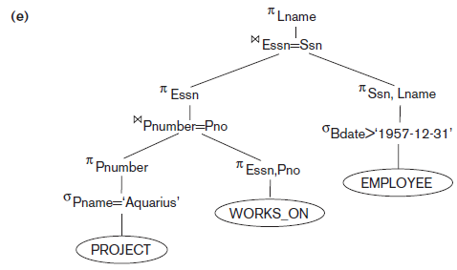
Query Transformation Example (cont’d.)
Figure 19.2 Steps in converting a query tree during heuristic optimization
(e) Moving PROJECT operations down the query tree.

Slide 13
General Transformation Rules for Rational Algebra Equations
Some transformation rules useful in query optimization
Cascade of σ
Conjunctive selection condition can be broken up into a cascade (sequence) of individual σ operations
σ _{c1 AND c2 AND ... AND cn}(R) = σ_{c1} (σ_{c2} (...(σ_{cn}(R))...) )
Commutativity of σ
The σ operation is commutative
σ_{c1} (σ_{c2}(R)) = σ_{c2} (σ_{c1}(R))

Slide 14
General Transformation Rules for Rational Algebra Equations
Cascade of π
In a cascade (sequence) of π operations, all but the last one can be ignored
π_{List1} (π_{List2} (...(π_{Listn}(R))...) ) = π_{List1}(R)
Commutativity of σ with π
If the selection condition c involves only the attributes A1, ..., An in the projection list, the two operations can be commuted
π_{A1, A2, ..., An} (σ_{c} (R)) = σ_{c} (π_{A1, A2, ..., An} (R))

Slide 15
General Transformation Rules for Rational Algebra Equations
Commutativity of (and x)
The operation is commutative as is the x operation
R _{C} S = S _{C} R; R x S = S x R
Commutativity of σ with (and x)
If all the attributes in the selection condition c involve only the attributes of one of the relations being joined—say, R—the two operations can be commuted as follows
σ_{c} ( R S ) = (σ_{c} (R)) S
σ_{c} ( R S ) = (σ_{c1} (R)) (σ_{c2} (S))
Other transformations

Slide 16
Summary of Heuristics for Algebraic Optimization
Apply first the operations that reduce the size of intermediate results
Perform SELECT and PROJECT operations as early as possible to reduce the number of tuples and attributes
The SELECT and JOIN operations that are most restrictive should be executed before other similar operations

Slide 17
19.2 Choice of Query Execution Plans
Materialized evaluation
Result of an operation stored as temporary relation
Pipelined evaluation
Operation results forwarded directly to the next operation in the query sequence

Slide 18
Nested Subquery Optimization
Unnesting
Process of removing the nested query and converting the inner and outer query into one block
Queries involving a nested subquery connected by IN or ANY connector can always be converted into a single block query
Alternate technique
Creating temporary result tables from subqueries and using them in joins

Slide 19
Nested Subquery Optimization – Example1
Nested subquery:
SELECT E1.Fname, E1.Lname
FROM EMLOYEE E1
WHERE E1.Salary = ( SELECT MAX (Salary)
FROM EMPLOYEE E2)
Max salary could be obtained just from the highest value in the index on salary (if one exists) or from the catalog.

Slide 20
Nested Subquery Optimization – Example2
Nested subquery (correlated):
SELECT Fname, Lname, Salary
FROM EMPLOYEE E
WHERE EXISTS ( SELECT *
FROM DEPARTMENT D
WHERE D.Dnumber = E.Dno AND D.Zipcode=30332);
Unnested query (nested subquery converted into join operation)
SELECT Fname, Lname, Salary
FROM EMPLOYEE E, DEPARTMENT D
WHERE D.Dnumber = E.Dno AND D.Zipcode=30332

Slide 21
Nested Subquery Optimization – Example3
Nested subquery:
SELECT COUNT(*)
FROM DEPARTMENT D
WHERE D.Dnumber IN ( SELECT E.Dno
FROM EMPLOYEE E
WHERE E.Salary > 200000)
Unnest subquery using semi-join.
SELECT COUNT(*)
FROM DEPARTMENT D, EMPLOYEE E
WHERE D.Dnumber S= E.Dno AND E.Salary > 200000

Slide 22
Subquery (View) Merging Transformation
Inline view
FROM clause subquery
View merging operation
Merges the tables in the view with the tables from the outer query block
Views containing select-project-join operations are considered simple views
Can always be subjected to this type of view-merging

Slide 23
Inline View-Merging Transformation - Example
Consider the following relations:
EMP (Ssn, Fn, Ln, Dno)
DEPT (Dno, Dname, Dmgrname, Bldg_id)
BLDG (Bldg_id, No_storeys, Addr, Phone)
Initial Query:
SELECT E.Ln, V.Addr, V.Phone
FROM EMP E, ( SELECT D.Dno, D.Dname, B.Addr, B.Phone
FROM DEPT D, BLDG B
WHERE D.Bldg_id = B.Bldg_id ) V
WHERE V.Dno = E.Dno AND E.Fn = “John”;
By using the merging transformation, Query becomes:
SELECT E.Ln, B.Addr, B.Phone
FROM EMP E, DEPT D, BLDG B
WHERE D.Bldg_id = B.Bldg_id AND D.Dno = E.Dno AND E.Fn = “John”;

Slide 24
Subquery (View) Merging Transformation (cont’d.)
Group-By view-merging
Delaying the Group By operation after performing joins may reduce the data subjected to grouping in case the joins have low join selectivity
Alternately, performing Group By early may reduce the amount of data subjected to subsequent joins
Optimizer determines whether to merge GROUP-BY views based on estimated costs

Slide 25
Group-by View-Merging Transformation - Example
Consider the following relations:
SALES (Custid, Productid, Date, Qty_sold)
CUST (Custid, Custname, Country, Cemail)
PRODUCT (Productid, Pname, Qty_onhand)

Slide 26
Group-by View-Merging Transformation - Example
View to count total quantity of any item bought for the <Custid, Productid> pairs:
CREATE VIEW CP_BOUGHT_VIEW AS
SELECT SUM (S.Qty_sold) as Bought, S.Custid, S.Productid
FROM SALES S
GROUP BY S.Custid, S.Productid;
Query using this view becomes:
SELECT C.Custid, C.Custname, C.Cemail
FROM CUST C, PRODUCT P, CP_BOUGHT_VIEW V1
WHERE P.Productid = V1.Productid AND C.Custid = V1.Custid
AND V1.Bought >50 AND Pname = “Ring_234” AND C.Country = “France”;
By using the merging transformation, Query becomes:
SELECT C.Custid, C.Custname, C.Cemail
FROM CUST C, PRODUCT P, SALES S
WHERE P.Productid = S.Productid AND C.Custid = S.Custid
AND Pname = “Ring_234” AND C.Country = “France”
GROUP BY P.Productid, C.Custid, C.Custname, C.Cemail
HAVING SUM (S.Qty_sold) > 50;

Slide 27
Materialized Views
View defined in database as a query
Materialized view stores results of that query
May be stored temporarily or permanently
Optimization technique
Using materialized views to avoid some of the computation involved in the query
Easier to read it when needed than recompute from scratch

Slide 28
Incremental View Maintenance
Update view incrementally by accounting for changes that occurred since last update
Join
Selection
Projection
Intersection
Aggregation

Slide 29
19.3 Use of Selectivities in Cost-Based Optimization
Query optimizer estimates and compares costs of query execution using different strategies
Chooses lowest cost estimate strategy
Process suited to compiled queries
Interpreted queries
Entire process occurs at runtime
Cost estimate may slow down response time

Slide 30
Use of Selectivities in Cost-Based Optimization (cont’d.)
Cost-based query optimization approach
For a given query subexpression, multiple equivalence rules may apply
Quantitative measure for evaluating alternatives
Cost metric includes space and time requirements
Design appropriate search strategies by keeping cheapest alternatives and pruning costlier alternatives
Scope of query optimization is a query block
Global query optimization involves multiple query blocks

Slide 31
Use of Selectivities in Cost-Based Optimization (cont’d.)
Cost components for query execution
Access cost to secondary storage
Disk storage cost
Computation cost
Memory usage cost
Communication cost

Slide 32
Catalog Information Used in Cost Functions
Information stored in DBMS catalog and used by optimizer
File size
Organization
Number of levels of each multilevel index
Number of distinct values of an attribute
Attribute selectivity
Allows calculation of selection cardinality
Average number of records that satisfy equality selection condition on that attribute

Slide 33
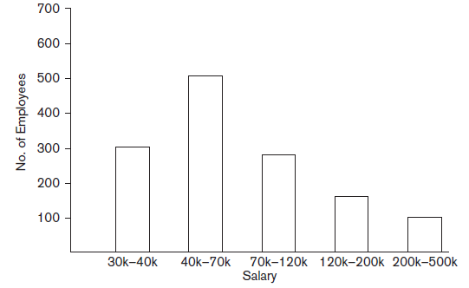
Histograms
Tables or data structures that record information about the distribution of data
RDBMS stores histograms for most important attributes
Figure 19.4 Histogram of salary in the relation EMPLOYEE

Slide 34
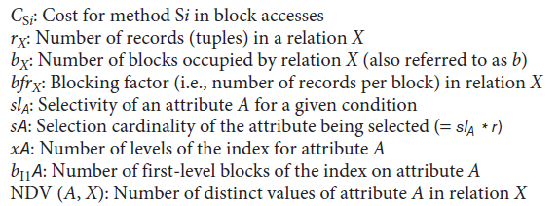
19.4 Cost Functions for SELECT Operation
Notation used in cost formulas

Slide 35
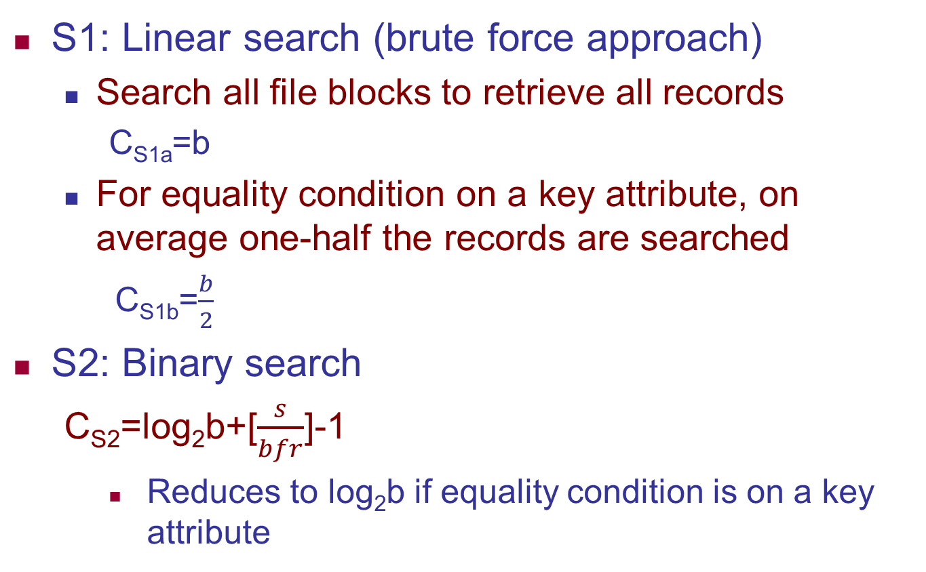
Cost Function for SELECT Operation (cont’d.)
S1: Linear search (brute force approach)
Search all file blocks to retrieve all records
C_{S1a}=b
For equality condition on a key attribute, on average one-half the records are searched
C_{S1b}=$\frac{b}{2}$
S2: Binary search
C_{S2}=log₂b+[$\frac{s}{bfr}$]-1
Reduces to log₂b if equality condition is on a key attribute

Slide 36
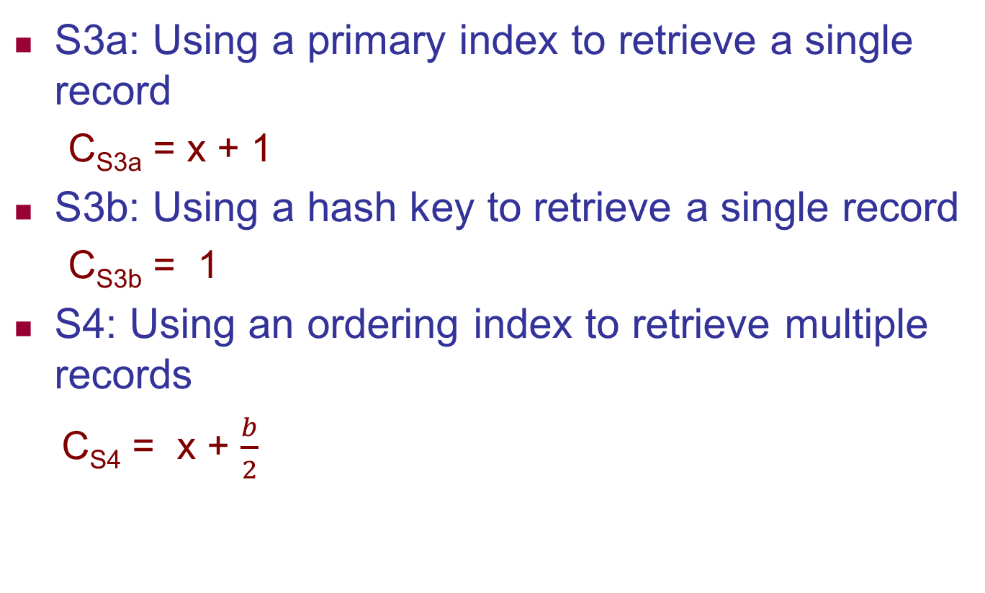
Cost Function for SELECT Operation (cont’d.)
S3a: Using a primary index to retrieve a single record
C_{S3a} = x + 1
S3b: Using a hash key to retrieve a single record
C_{S3b} = 1
S4: Using an ordering index to retrieve multiple records
C_{S4} = x + $\frac{b}{2}$

Slide 37
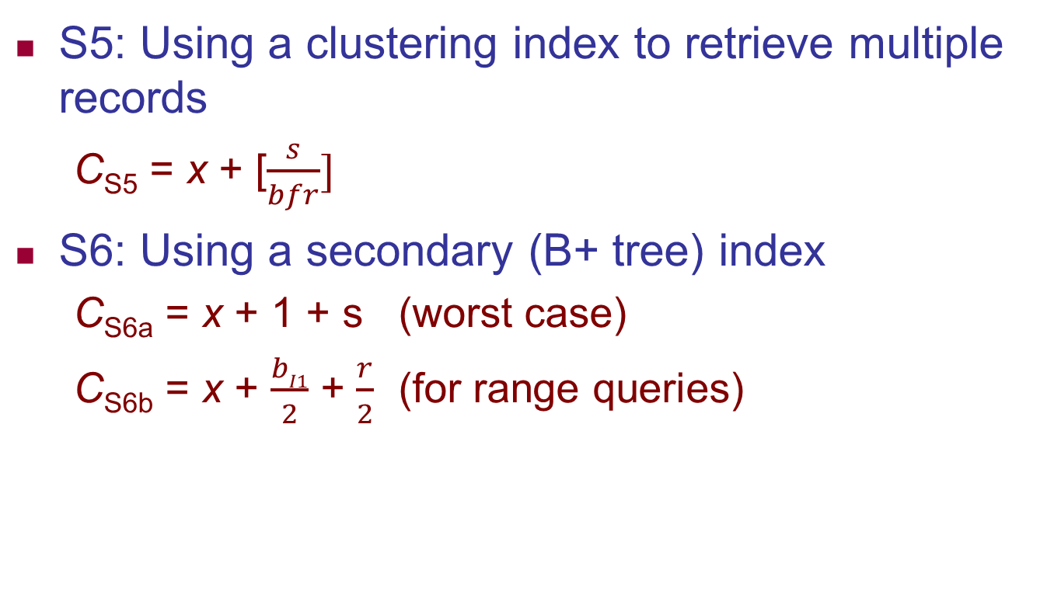
Cost Functions for SELECT Operation (cont’d.)

Slide 38
Cost Functions for SELECT Operation (cont’d.)
Dynamic programming
Cost-based optimization approach
Subproblems are solved only once
Applies when a problem has subproblems that themselves have subproblems

Slide 39
Example of Optimization of Selection Based on Cost Formulas
Suppose that the EMPLOYEE file has r_{E} = 10,000 records stored in b_{E} = 2,000 disk blocks with blocking factor bfr_{E} = 5 records/block and the following access paths:
A clustering index on Salary, with levels x_{Salary} = 3 and average selection cardinality s_{Salary} = 20. (This corresponds to a selectivity of sl_{Salary} = 20/10000 = 0.002)
A secondary index on the key attribute Ssn, with xSsn = 4 (s_{Ssn} = 1, sl_{Ssn} = 0.0001).
A secondary index on the nonkey attribute Dno, with x_{Dno} = 2 and first-level index blocks b_{l1Dno} = 4. There are NDV (Dno, EMPLOYEE) = 125 distinct values for Dno, so the selectivity of Dno is sl_{Dno} = (1/NDV (Dno, EMPLOYEE) = 0.008, and the selection cardinalty is s_{Dno} = (r_{E} * sl_{Dno}) = (r_{E}/NDV (Dno, EMPLOYEE)) = 80.
A secondary index on Sex, with x_{Sex} = 1. There are NDV (Sex, EMPLOYEE) = 2 values for the Sex attribute, so the average selection cardinality is s_{Sex} = (r_{E}/NDV (Sex, EMPLOYEE)) = 5000.

Slide 40
Example of Optimization of Selection Based on Cost Formulas
The use of cost functions with the following examples:
OP1: σSsn=‘123456789’ (EMPLOYEE)
OP2: σDno > 5 (EMPLOYEE)
OP3: σDno = 5 (EMPLOYEE)
OP4: σDno=5 AND SALARY>30000 AND Sex=‘F’ (EMPLOYEE)
For OP1 we can use either method S1 or S6a
The cost of linear search option S1: (poor)
C_{S1b} = (b_{E}/2) = 1000 (average cost for a selection on a key attribute).
The cost of indexed access path option S_{6a} : (best)
C_{S6a} = x_{Ssn} + 1 = 4 + 1 = 5

Slide 41
Example of Optimization of Selection Based on Cost Formulas
For OP2: σDno > 5 (EMPLOYEE) we can use either method S1 or S6b
The cost of linear search option S1: (best)
C_{S1a} = b_{E} = 2000 (for a selection on a nonkey attribute)
The cost of indexed access path option S6b : (poor)
C_{S6b} = x_{Dno} + (b_{I1Dno}/2) + (r_{E} /2)
= 2 + (4/2) + (10,000/2) = 5,004

Slide 42
Example of Optimization of Selection Based on Cost Formulas
For OP3: σDno = 5 (EMPLOYEE) we can use either method S1 or S6a
The cost of linear search option S1: (poor)
C_{S1a} = b_{E} = 2000 (for a selection on a nonkey attribute)
The cost of indexed access path option S6a : (best)
C_{S6a} = x_{Dno} + s_{Dno}
= 2 + 80 = 82

Slide 43
Example of Optimization of Selection Based on Cost Formulas
For OP4: σ Dno=5 AND SALARY>30000 AND Sex=‘F’ (EMPLOYEE)
we need to estimate the cost of using any one of the three components of the selection condition to retrieve the records, plus the linear search approach.
The cost of linear search option S1:
C_{S1a} = b_{E} = 2000 (for a selection on a nonkey attribute)
The cost of Dno indexed access path option S6a : (best)
C_{S6a} = x_{Dno} + s_{Dno} = 2 + 80 = 82
The cost of Salary indexed access path option S5 :
C_{S5} = x_{Salary} + s/bfr = 3 + 5000/5 = 1003
The cost of Sex indexed access path option S6a :
C_{S6a} = x_{Sex} + s_{Sex} = 1 + 5000 = 5001

Slide 44

19.5 Cost Functions for the JOIN Operation
Cost functions involve estimate of file size that results from the JOIN operation
Join selectivity
Ratio of the size of resulting file to size of the CARTESIAN PRODUCT file
Simple formula for join selectivity
Join cardinality

Slide 45

Cost Functions for the JOIN Operation (cont’d.)
J1: Nested-loop join
For three memory buffer blocks:
For n_{B} memory buffer blocks:
J2: Index-based nested-loop join
For a secondary index with selection cardinality S_{B} for join attribute B of S:

Slide 46


Cost Functions for the JOIN Operation (cont’d.)
J3: Sort-merge join
For files already sorted on the join attributes
Cost of sorting must be added if sorting needed
J4: Partition-hash join

Slide 47




Cost Functions for the JOIN Operation (cont’d.)
Join selectivity and cardinality for semi-join
Unnesting query above leads to semi-join
Join selectivity
Join cardinality

Slide 48
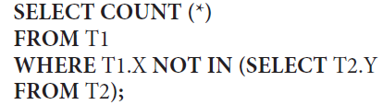


Cost Functions for the JOIN Operation (cont’d.)
Join selectivity and cardinality for anti-join
Unnesting query above leads to anti-join
Join selectivity
Join cardinality

Slide 49
Cost Functions for the JOIN Operation (cont’d.)
Multirelation queries and JOIN ordering choices
Left-deep join tree
Right-deep join tree
Bushy join tree

Slide 50
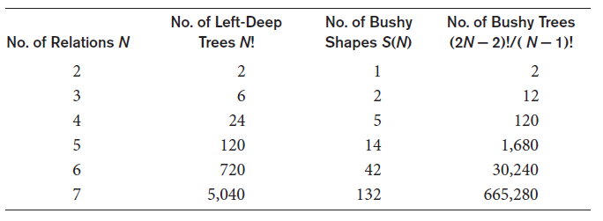
Cost Functions for the JOIN Operation (cont’d.)
Multirelation queries and JOIN ordering choices
Left-deep join tree
Right-deep join tree
Bushy join tree
Table 19.1 Number of permutations of left-deep and bushy join trees of n relations

Slide 51
Cost Functions for the JOIN Operation (cont’d.)
Physical optimization involves execution decision at the physical level
Cost-based physical optimization
Top-down approach
Bottom-up approach
Certain physical level heuristics make cost optimizations unnecessary
Example: for selections, use index scans whenever possible

Slide 52
Cost Functions for the JOIN Operation (cont’d.)
Left-deep trees generally preferred
Work well for common algorithms for join
Able to generate fully pipelined plans
Characteristics of dynamic programming algorithm
Optimal solution structure is developed
Value of the optimal solution is recursively defined
Optimal solution is computed and its value developed in a bottom-up fashion

Slide 53
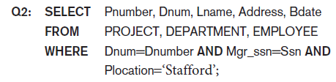
19.6 Example to Illustrate Cost-Based Query Optimization
Example: Consider Q2 below and query tree from Figure 19.1(a) on slide 6
Information about the relations shown in Figure 19.6 (next slide)

Slide 54
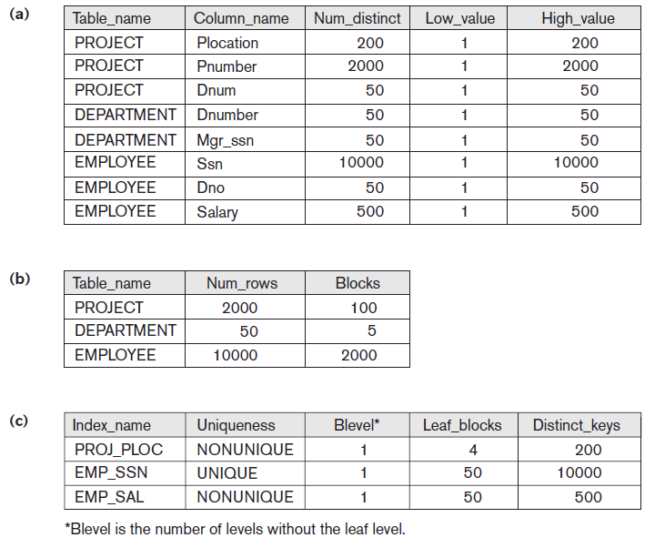
Figure 19.6 Sample statistical information for relations in Q2.
(a) Column information (b) Table information (c) Index information

Slide 55
Example to Illustrate Cost-Based Query Optimization (cont’d.)
Assume optimizer considers only left-deep trees
Evaluate potential join orders
PROJECT DEPARTMENT EMPLOYEE
DEPARTMENT PROJECT EMPLOYEE
DEPARTMENT EMPLOYEE PROJECT
EMPLOYEE DEPARTMENT PROJECT

Slide 56
19.7 Additional Issues Related to Query Optimization
Displaying the system’s query execution plan
Oracle syntax
EXPLAIN PLAN FOR <SQL query>
IBM DB2 syntax
EXPLAIN PLAN SELECTION [additional options] FOR <SQL-query>
SQL server syntax
SET SHOWPLAN_TEXT ON or SET SHOWPLAN_XML ON or SET SHOWPLAN_ALL ON

Slide 57
Additional Issues Related to Query Optimization (cont’d.)
Size estimation of other operations
Projection
Set operations
Aggregation
Outer join
Plan caching
Plan stored by query optimizer for later use by same queries with different parameters
Top k-results optimization
Limits strategy generation

Slide 58
19.8 An Example of Query Optimization in Data Warehouses
Star transformation optimization
Goal: access a reduced set of data from the fact table and avoid using a full table scan on it
Classic star transformation
Bitmap index star transformation
Joining back

Slide 59
19.9 Overview of Query Optimization in Oracle
Physical optimizer is cost-based
Scope is a single query block
Calculates cost based on object statistics, estimated resource use and memory needed
Global query optimizer
Integrates logical transformation and physical optimization phases to generate optimal plan for entire query tree
Adaptive optimization
Feedback loop used to improve on previous decisions

Slide 60
Overview of Query Optimization in Oracle (cont’d.)
Array processing
Hints
Specified by application developer
Embedded in text of SQL statement
Types: access path, join order, join method, enabling or disabling a transformation
Outlines used to preserve execution plans
SQL plan management

Slide 61
19.10 Semantic Query Optimization
Uses constraints specified on the database schema
Goal: modify one query into another that is more efficient to execute
Consider the following SQL query,
SELECT E.LNAME, M.LNAME
FROM EMPLOYEE E, EMPLOYEE M
WHERE E.SUPERSSN=M.SSN AND E.SALARY>M.SALARY
Explanation:
Suppose that we had a constraint on the database schema that stated that no employee can earn more than his direct supervisor. If the semantic query optimizer checks for the existence of this constraint, it need not execute the query at all because it knows that the result of the query will be empty.

Slide 62
19.11 Summary
Query trees
Heuristic approaches used to improve efficiency of query execution
Reorganization of query trees
Pipelining and materialized evaluation
Cost-based optimization approach
Oracle query optimizer
Semantic query optimization

